Slide 1

Yik-Yak:
Tips, Leads, and Cliffhangers

Slide 2
What it is...
Yik Yak is a location-based app that connects people nearby
Lets people “share news, ask questions, offer support” with people who are in the same place at the same time
Audience: college students
September 2014: 3rd most downloaded app
April 2016: 1067th most downloaded app
Now: 1.76 million monthly users

Slide 3
Features...
Originally… completely anonymous posts
Now: usernames
“YAK” – post an opinion, a question… whatever’s on your mind
CHAT – interact with nearby Yak users by replying to a post… private messaging
EXPLORE – see local yakers, discover trending topics, engage in national and even global “herds”
HERD – thread

Slide 4
Relationship to News...
Can localize opinions
Search for leads… opinions/ reports → stories
BBC: Feb. 2016, asked about mental health issues
  Hundreds of responses and thousands of engagements (votes)
  Anonymous and honest responses “hard to get through Facebook”
  http://digiday.com/publishers/how-bbc-is-using-yik-yak-to-talk-to-millennials-and-get-them-to-talk-back/
BBC: also used during Canadian election fall 2015, asking about issues

Slide 5
Leads without sources...
… are just cliffhangers? Or rumors?
Sep. 2014: rumored sexual assault at USC at Lambda Chi
  Little evidence, all found on Yik Yak
  Disturbing comments about sexual assault
  Unfounded?
  http://dailytrojan.com/2014/09/16/yik-yak-breeds-rumors-and-cyberbullying/
April 2015: nepotism in USG?
  Comments on Yik Yak accusing Pres. Sampath of nepotism in making cabinet appointments
  Student posted on ATVN and Huffington Post about controversy, accusing Sampath of being involved in “vote-buying, corruption, and nepotism”
  Sampath and team fought back… accused student of LIBEL
  http://dailytrojan.com/2015/04/07/usg-announces-executive-cabinet/

Slide 6
My own experience...
Question: Trump supporters – do you hide your support for him? If not, what are your friends’ reactions when you tell them who you’re voting for?
25 responses over 7 hours, many responding to each other

Slide 7
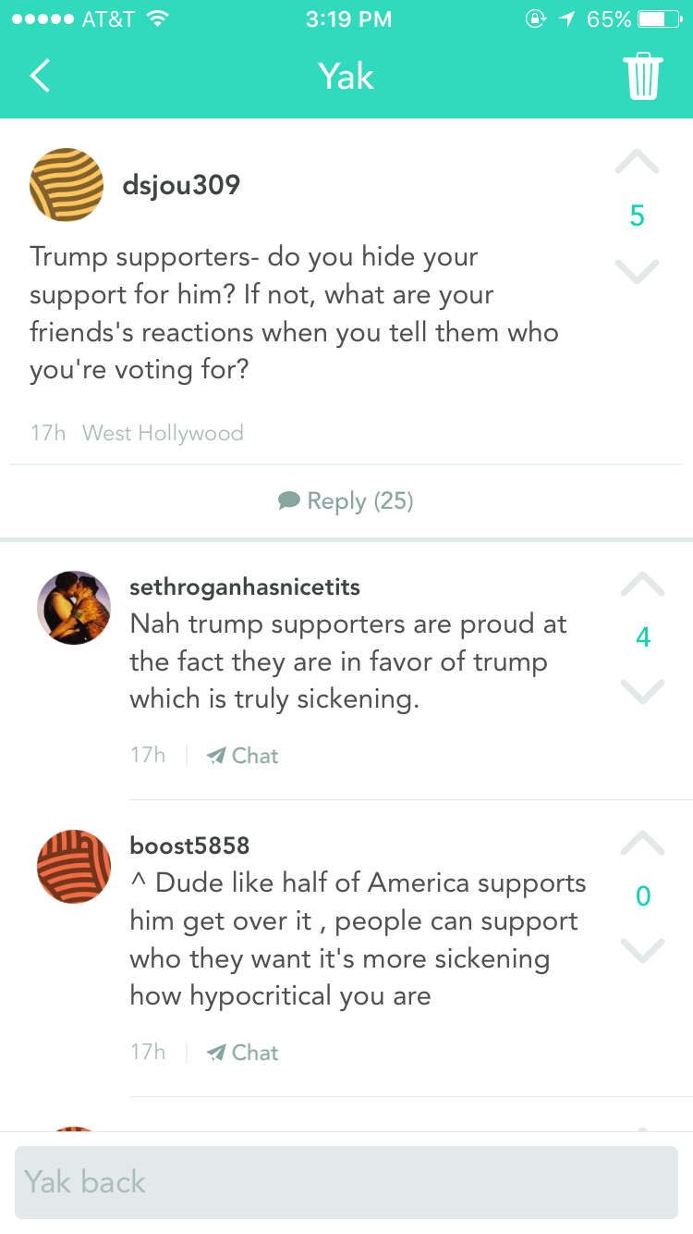
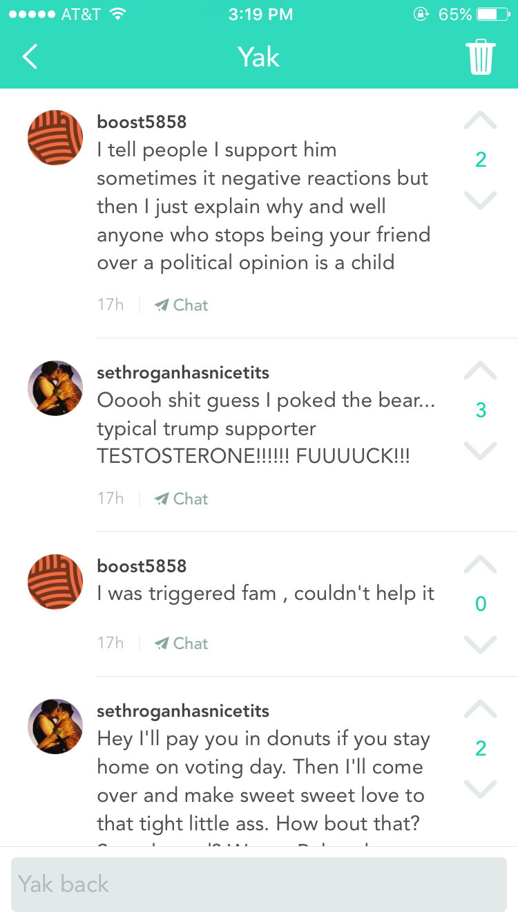
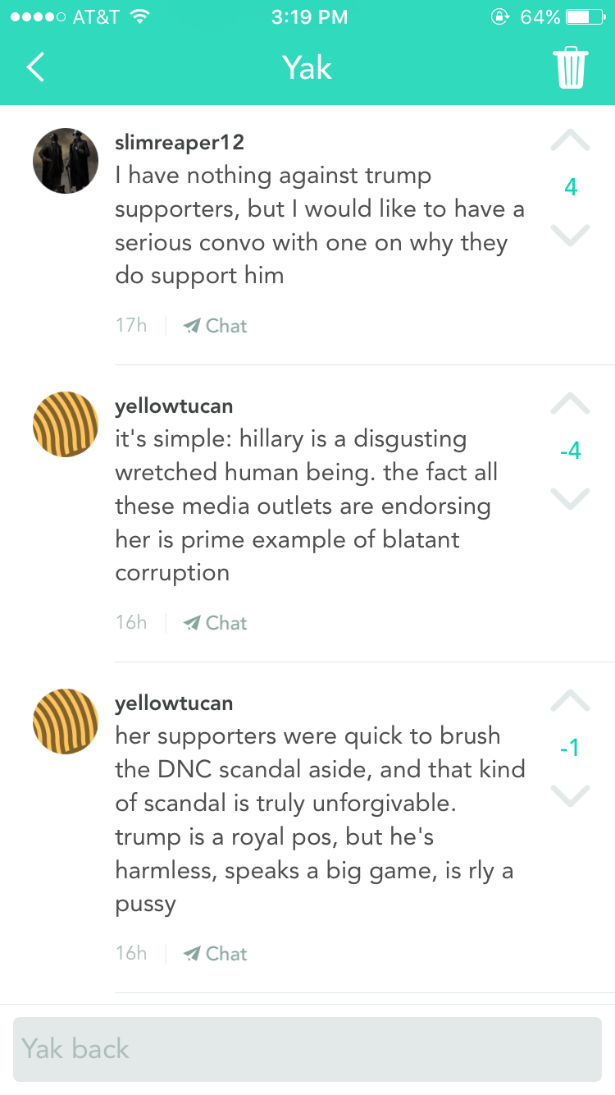
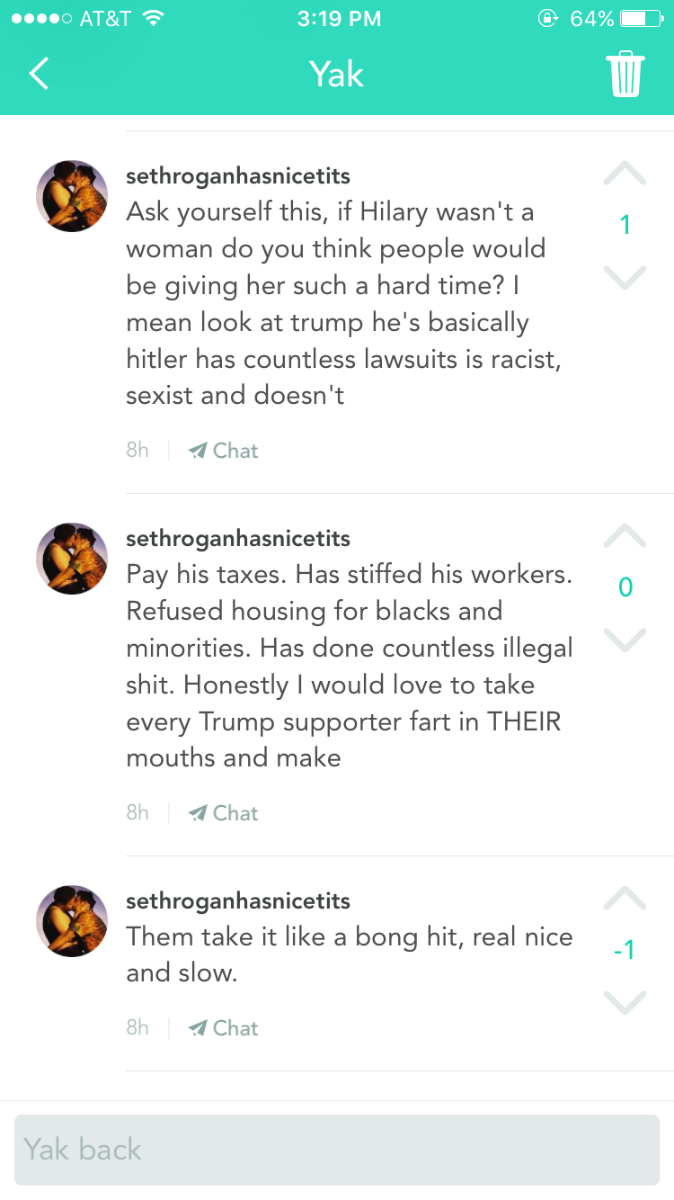
Responses...

Slide 8
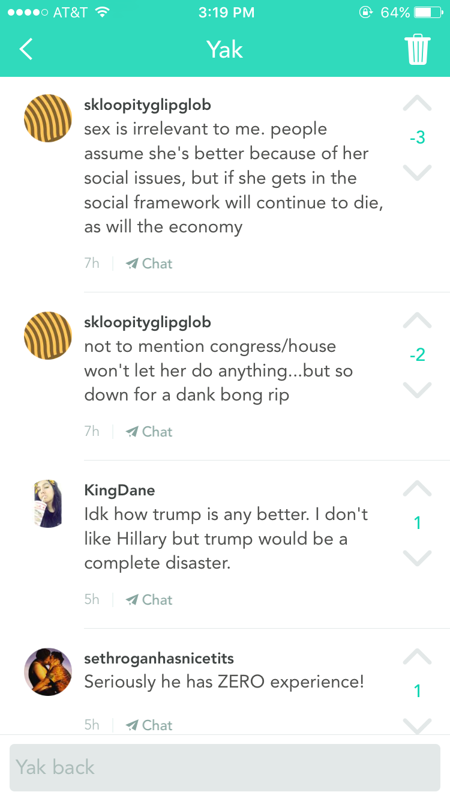
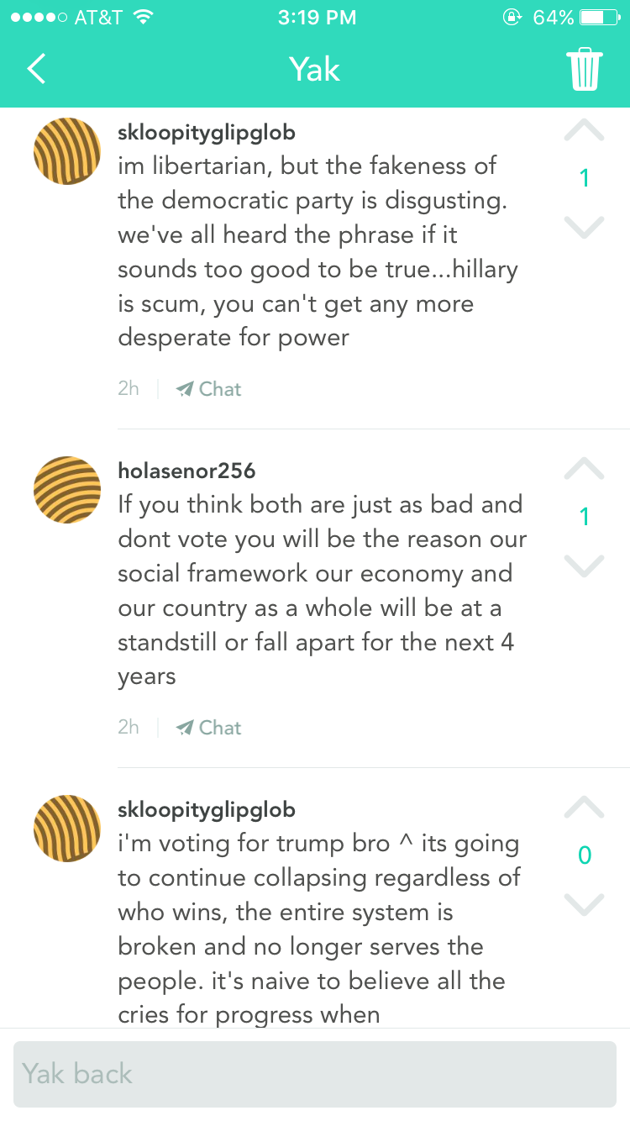
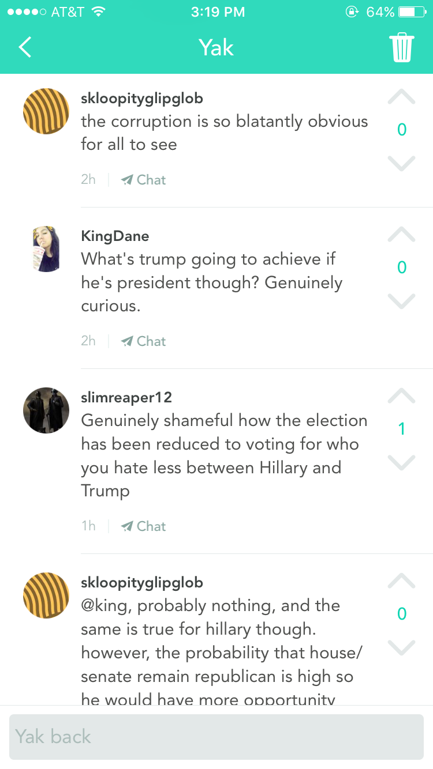
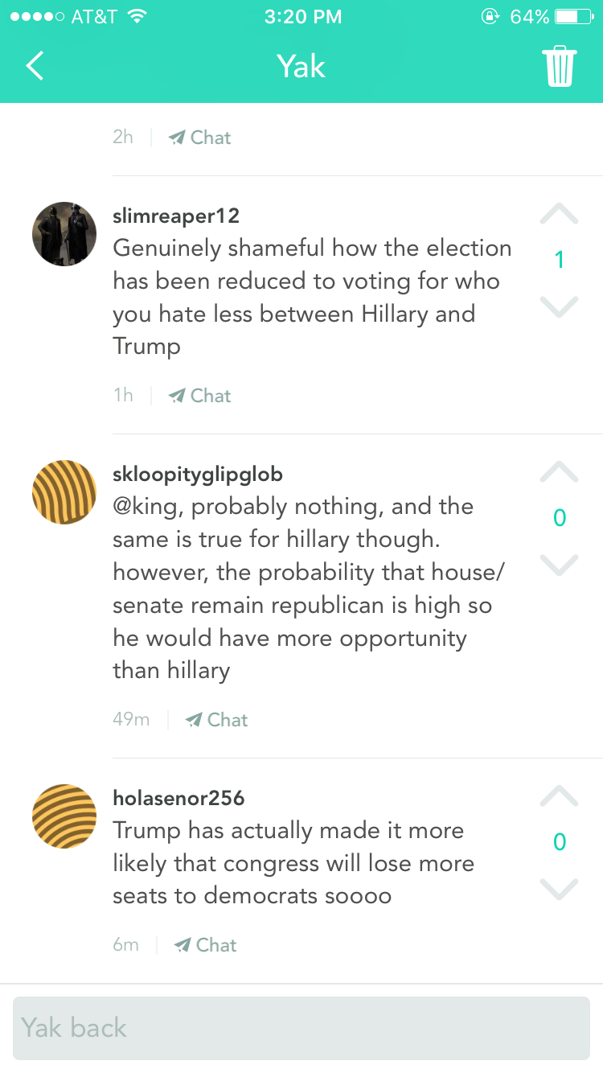
Responses, cont...

Slide 9
Conclusions...
Yik Yak is great for tips, leads, and potential stories
Yik Yak is NOT a source, but can lead to sources
Anonymity → trolling, vulgar content
Anonymity → honesty, private opinions

